Slide 1

Documentation Enhancement
and
Content Creation
Jessica Ricks
jessica.ricks117@gmail.com
www.linkedin.com/in/jessicaricks

Slide 2

Enhancing Existing
Documentation
Notes:
I’d like to start off with some of the things I really liked about the documentation: Playing with some Flare tools that I have always wanted to use.
Using the filters for the search function in Flare makes it easier for the customer to find relevant topics
Making use of the thumbnails feature in Flare makes screenshots easier to read and easier to put in print materials
Making use of the glossary links in topics makes defining unfamiliar terms less cumbersome for customers
Organizing the docs site by role goes back to the point I made about how this helps the customer filter for relevant info
For the first part of this presentation, I would like to share some suggestions for enhancing product documentation based on my observations of the docs website.

Slide 3




Design
Match the color scheme of OpenX.com
Increase Home screen column spacing
Lock header and breadcrumbs position
Add a favicon to the browser tab
Notes:
Observation the First: DESIGN
The first thing that jumped out at me was the color scheme. I’d match the color scheme of OpenX.com. The design is similar, it’s brighter, which may make it look less intimidating to the novice user. [CLICK AWAY]
The second thing I noticed on the Home screen was the column spacing in the footer area. [Click Away]
This one is a personal preference. Navigating away from long web pages is a pain point of mine when browsing the web, so when designing a Flare skin, I like locking the header and breadcrumbs in order to keep navigation tools visible while scrolling through a long topic. [Nav to site to demo, if possible]
A favicon can be added in the header tag of the master pages.

Slide 4
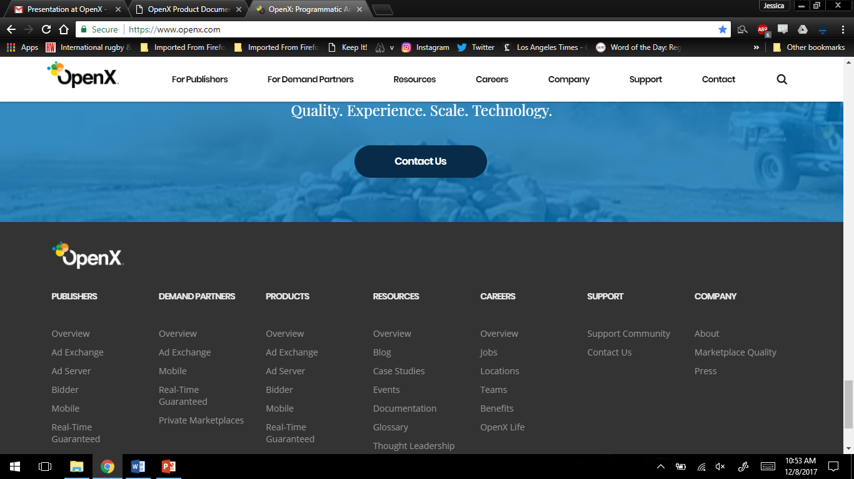
OpenX Website
White header
Dark grey footer
Notes:
Looking at OpenX.com for inspiration:
The white header provides a nice contrast for the OpenX logo. On the Docs website, part of the logo almost blends into the background.
As for the footer, I just really like the dark grey background in the footer. Also, a light font on a dark background is really easy to read. I would do the same for the links on the Docs Home page. [CLICK BACK TO SLIDE 2]

Slide 5
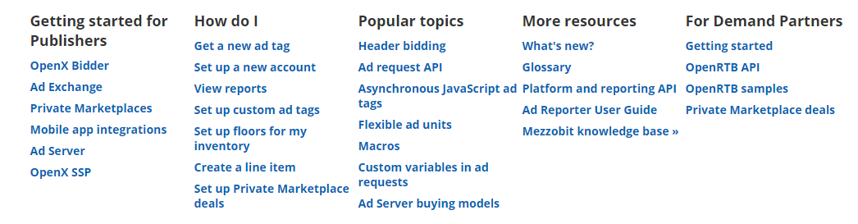
OpenX Documentation Website: Bottom Navigation
Too-Narrow column spacing
Causing Crowding
OpenX Website: Bottom Navigation
Wider column spacing
Notes:
Looking once again at OpenX.com for inspiration:
The columns on the docs site are a little too close together. A simple solution is to decrease the font size. Increasing the width of the div is another possibility. [Click back]

Slide 6
Favicons add polish and professionalism
Favicon
Notes:
The little icon that appears in the browser tab is what I’m talking about.
The link to the icon goes between the header tags in the master pages. It’s a little buggy in Flare, but I do know how to do it.

Slide 7


Screenshots
Break the “Wall of Text”
Simplify procedures
It’s worth the effort to make things easy on your customers!
Notes:
Second observation: Not a lot of screenshots
Screenshots are not always necessary, but I am a big fan of them for two reasons:
Users go to the documentation to quickly answer their questions. Graphics and lists help break up long walls of text, which makes it easier for the user to find what they’re looking for without either reading the whole topic first, or resorting to Ctrl+F (which is my go to).
A screenshot can very quickly show what settings to use for something, where a button is located on the screen, and if they’re on the correct screen while navigating a procedure.

Slide 8



Navigation Overview
Screenshot of the interface
Sections of the application
Common buttons and icons
Notes:
Third observation: No general navigation overview of each product.
Again, not always necessary, but may be helpful for small identifying common items, like the action buttons I see on the Adding Sites topic.
I generally include stuff like:
A screenshot of the interface that is seen when the user opens the application with arrows and boxes pointing out the parts and pieces.
Split the topic into sections that match the sections in the software and very briefly introduce what they are. Link to the relevant topics.
Common buttons or icons

Slide 9
Questions?
Notes:
Those are my three quick suggestions for the future.
Does anyone have any questions on that?

Slide 10
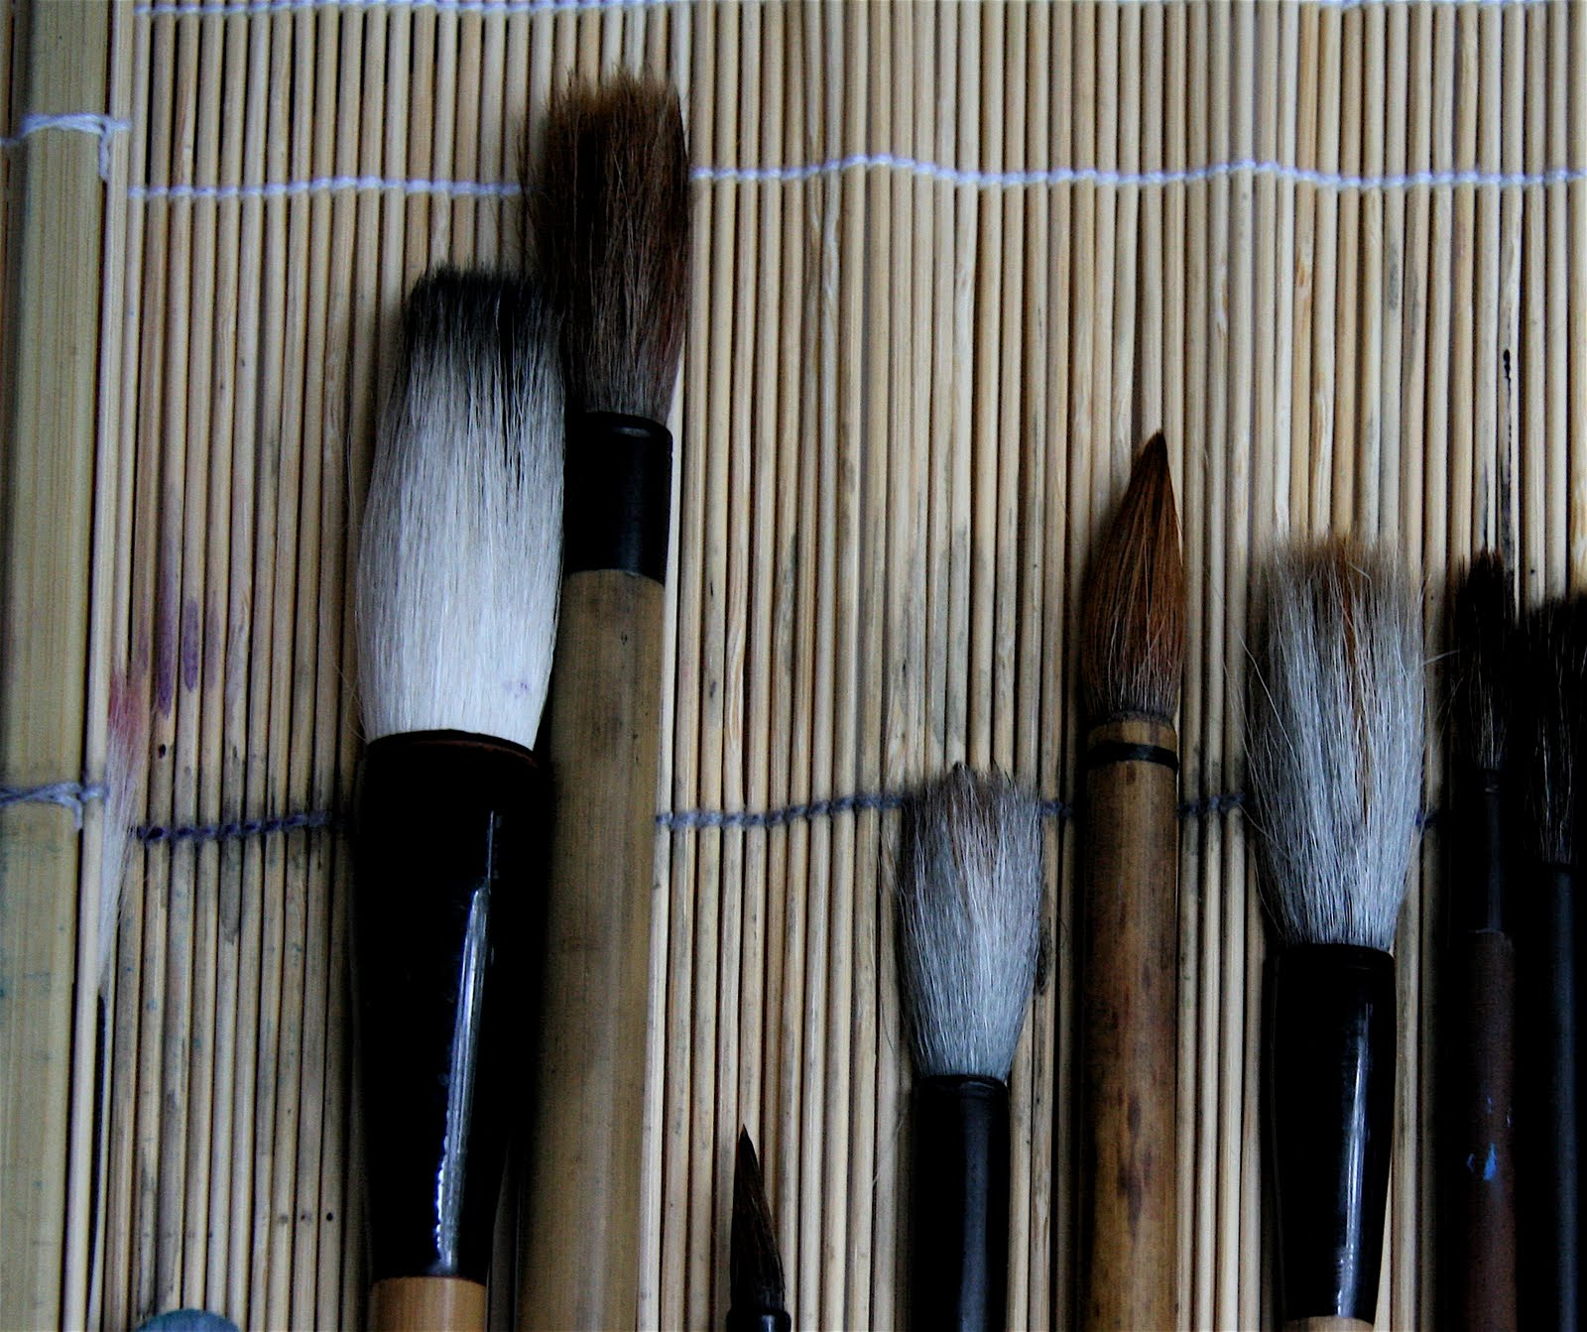
Creating
New Content
Notes:
Moving on to the second part of my presentation: How do I create new content from scratch?

Slide 11
Research
Organize
Write
Notes:
I broke my method for content creation into a three step process:
Research
Organization
And Writing and editing

Slide 12



Research
Play with the software
Discover use cases
Determine workflow
Notes:
Play with the software to come up with targeted questions for the SME.
What problem is the user trying to solve with the software? This helps put me into the user’s shoes, and that leads me to workflow.
How is the user going to use the software? Splitting the software into logical topics means finding the workflow.
What are the major processes? Scan, Analyze, Report…
What does a novice user need to know right away?
What should the top level topics be?

Slide 13
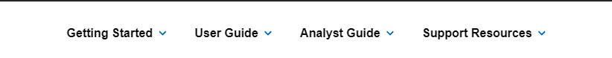



Getting Started topics for new users
Top Level
Organization
A guide for each type of user
Additional support resources
Notes:
My next step is organization.
To use an example of a top nav project I created from scratch:
Arrow: Top level of the manual. In this case, directed the user to their role and to additional resources. If there were a single role, I might separate by workflow (if the workflow is relatively short – like a 3-4 step process).
Getting Started: An introduction for the first-time user.
User Guide: A guide to the processes that make up the core of the application.
Analyst Guide: A high-level guide to processes for Analysts only.
Support Resources: Where else can I go for help. Contains downloads, link to the KB, link to community site, link to Support site, and links to the help for related products(this product was in a suite of products – including an Admin tool for all of them).
Box: Quick access to things the user might be looking for, such as downloads or system requirements. I like having a “What’s New” section here to cover major releases and patches (and link to the changes in the documentation).

Slide 14
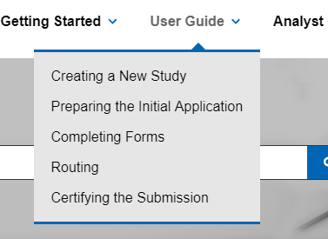

Lower Level
Organization
Organized by workflow
Like tax software
Organized by task type
Like Photoshop
Notes:
The User Guide in this application had a definitive workflow. The user creates a study, fills out a form, and sends the application for approval.
Another way you might organize a manual is by task type. There are some applications, MS Word for example, that simply Do Things. In which case, you’re going to organize topics by tasks, such as Creating a Chart or Creating a table. How to organize those tasks? Well, you might organize by real estate, which is very easy for an app like Word where you can organize tasks by tab.

Slide 15


Write the content
Consider tips, notes, and warnings
Write It
Reorganize content
Take screenshots
Notes:
And my final step is writing, which includes editing and publishing.
Step 1: Write the content with the software open (may find issues missed by QA). Going through the workflow end to end.
Tips: Are there any sidebar notes that don’t fit into the narrative, but are useful to the user? Tips, notes, warnings. Tips are helpful hints that are not necessary for making the app function. Notes are necessary, but not game breaking (e.g. reminding the use to save their work). Warnings are game breakers.
Reorganization: Sometimes I find that a topic fits better elsewhere in the manual. This usually occurs with software that has no clear workflow.
Screenshots: Are screenshots necessary? What information am I conveying in the screenshot? What do I need to show in the screenshot? Do I need to add arrows, boxes, or cursors to the screenshot?

Slide 16



Editing
Edit It
Expert review
Peer review and edit
Notes:
This is a pretty simple step.
Attention to detail when editing. Check formatting, check grammar, check accuracy.
Check with the SME for accuracy.
Peer review (if possible). Second set of eyes looking at your formatting and checking your grammar.

Slide 17

Build the outputs for distribution
Publish It
Send to all necessary parties
Notes:
Outputs may include print guides, which often need to be adjusted for breaks and it needs to be moved into the correct folder.
As for sending out links and print guides: Usually the PO will want the link, tech support may want it, and professional services may want it as well. And you have to post it in all the right places.
And that is my final step in creating a project from scratch.

Slide 18
Questions?

Slide 19
Thank You!

